Slide 1
Assignment 2 – Pacemaker V2.0
JEFFY ABRAHAM, abraham_jeffy@yahoo.com

Slide 2
Assignment : Pacemaker 2.0
Commands/Features
Test Driven Development Practices
Build & Deployment
Language Features

Slide 3
Commands / Features (Starter)
List Users: List all users emails, first and last names | gu get-users ()
Register: Create an account for a new user | ru register-user (first name, last name, email, password)
Login: Log in a registered user in to pacemaker | lu login-user (email, password)
Logout: Logout current user | l logout ()
Add activity: create and add an activity for the logged in user | aa add-activity (type, location, distance)
List Activities: List all activities for logged in user | la list-activities ()
Starter Commands Provided in
Lab Solutions

Slide 4
Commands / Features (Baseline) |  | Attempted? | Status
List Activity Location: List all locations for a specific activity | lal list-activity-locations (activity-id) | YES | SUCCESS
Follow Friend: Follow a specific friend | f follow (email) | YES | SUCCESS
List Friends: List all of the friends of the logged in user | lf list-friends () | YES | SUCCESS
Friend Activity Report: List all activities of specific friend, sorted alphabetically by type | far friend-activity-report (email) | YES | SUCCESS
Add location: Append location to an activity" | al add-location (activity-id, lat, lng) | Provided in Lab Solutions
ActivityReport: List all activities for logged in user, sorted alphabetically by type | ar activity-report () | Provided in Lab Solutions

Slide 5
Commands / Features (Good) |  | Attempted? | Status
Activity Report: List all activities for logged in user by type. Sorted longest to shortest distance | ar activity-report (byType: type) | YES | SUCCESS
Unfollow Friends: Stop following a friend | uf unfollow-friend () | YES | Partially
Message Friend: send a message to a friend | mf message-friend (email, message) | YES
List Messages: List all messages for the logged in user | lm list-messages () | YES | SUCCESS
Distance Leader Board: list summary distances of all friends, sorted longest to shortest | dlb distance-leader-board () | ---
Friend Activity Report: List all activities of specific friend, sorted alphabetically by type | ar activity-report (byType: type)

Slide 6
Commands / Features (Excellent) |  | Attempted? | Status
Distance Leader Board: distance leader board refined by type | dlbbt distance-leader-board-by-type (byType: type)
Message All Friends: send a message to all friends" | maf message-all-friends (message)
Location Leader Board: list sorted summary distances of all friends in named location | llb location-leader-board (location)

Slide 7
Commands / Features (Outstanding) |  | Attempted? | Status
pacemaker-service deployed to cloud pacemaker-client access cloud service | Admin Account Define commands to administer service, to include: remove users disable/enable users report user stats (nmr logins, average number of activities etc...)

Slide 8
Assignment : Pacemaker 2.0
Commands/Features
Test Driven Development Practices
Build & Deployment
Language Features

Slide 9
TDD Practices
Starter | 30% Coverage
Baseline | 40% Coverage
Good | 50% Coverage
Excellent | 65% (with Mocking)
Outstanding | 80% (with Mocking)
Code Coverage Achieved: xx%
Mocking Approach Adopted:

Slide 10
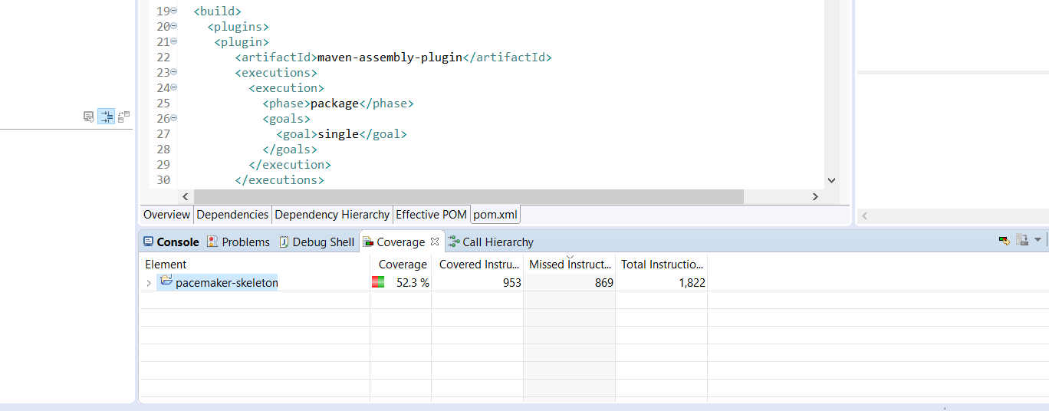
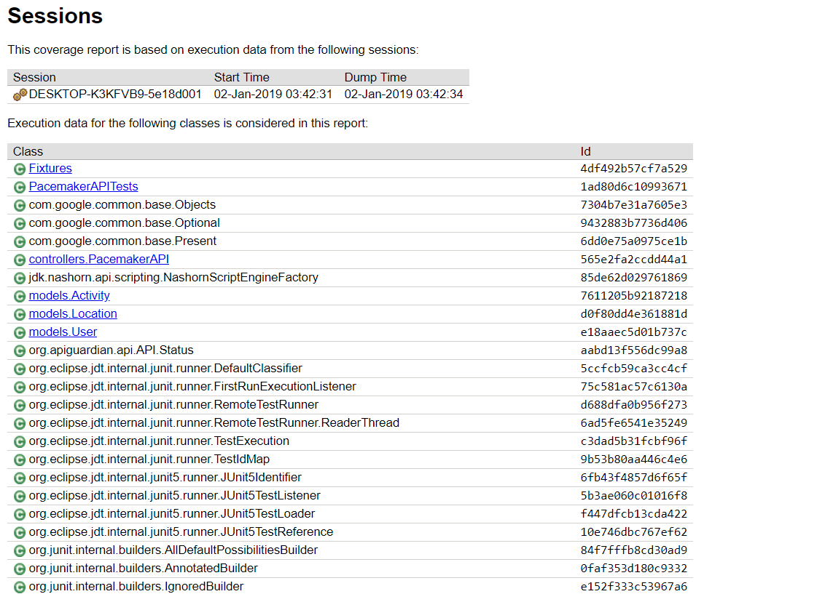
Code Coverage Screen Shot / Report

Slide 11
Assignment : Pacemaker 2.0
Commands/Features
Test Driven Development Practices
Build & Deployment
Language Features

Slide 12
Build and Deployment |  | Status | URLs (where appropriate)
Starter | Eclipse project archive pacemaker-console
Baseline | github repo pacemaker-console | SUCCESS | https://github.com/JeffyAbraham/pacemaker
Good | maven github repos: - pacemaker-service pacemaker-console
Excellent | pacemaker-service provides REST API pacemaker-console access API (over http)
Outstanding | pacemaker-service deployed to cloud pacemaker-client access cloud service | SUCCESS | https://agile-retreat-72617.herokuapp.com/USERS

Slide 13
Assignment : Pacemaker 2.0
Commands/Features
Test Driven Development Practices
Build & Deployment
Language Features

Slide 14
Language Features |  | Approach adopted (brief)
Starter | Java | n/a
Baseline | Java | n/a
Good | Java with Lamdbas | LAMBDAS HAS BEEN USED
Excellent | Java with Streams OR Kotlin | STREAMS HAS BEEN USED TO LIST FRIENDS
Outstanding | Kotlin

Slide 15
Demo

